Slide 1
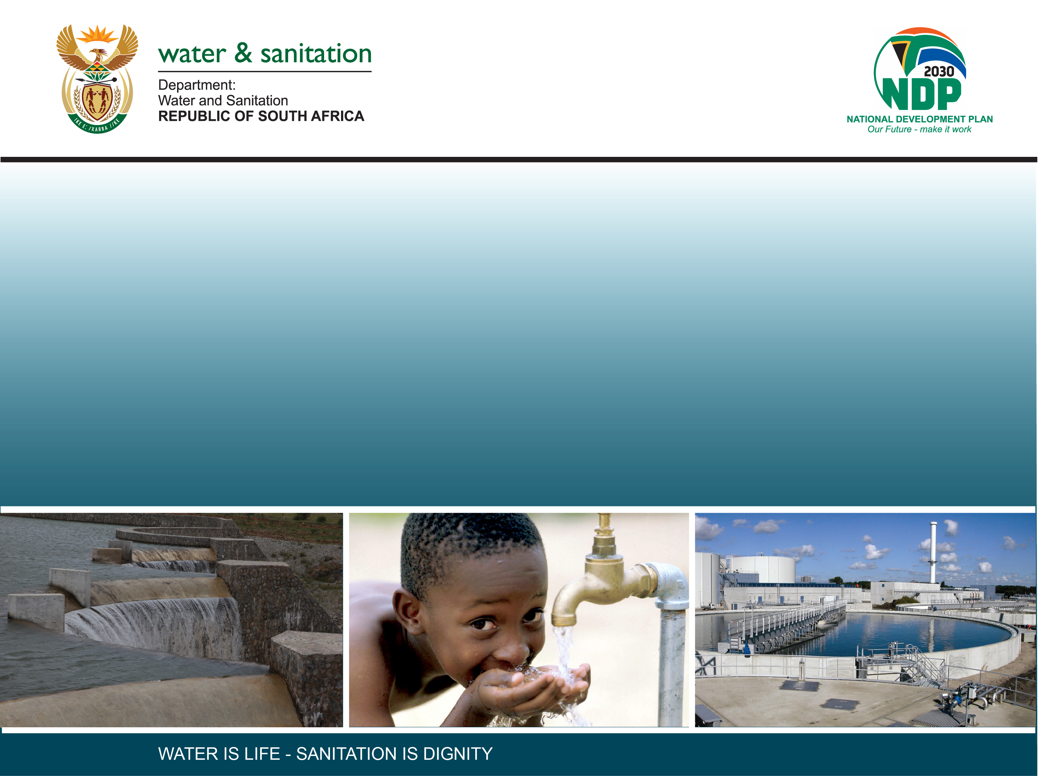
CLASSIFICATION OF SIGNIFICANT WATER RESOURCES AND DETERMINATION OF RESOURCE QUALITY OBJECTIVES FOR WATER RESOURCES IN THE USUTU TO MHLATHUZE CATCHMENTS (WP11387)
BACKGROUND
Presentation by:
Mkhevu Mnisi
Date: 07 June 2022
PSC MEETING 1: 07JUNE 2022

Slide 2
PRESENTATION CONTENT
Legal mandate
Definition of Resource Directed Measures (RDM)
Study processes/steps
Study area
Stakeholder Engagement Plan
Communication method
Contact details

Slide 3
Legal Mandate
Chapter 3 of the National Water Act (No. 36 of 1998), deals with the protection of water resources
The Resource-Directed Measures for protection of water resources are:
  Classification (S13)
  Reserve (S16)
  Resource Quality Objectives (S13)
S12 requires the Minister to establish the Water Resource Classification System, (WRCS)
WRCS was published as Regulation 810 in Government Gazette No. 33541 dated 17 September 2010
The WRCS defines:
  water resource classes and
  the procedure to determine Class, RQOs and Reserve
According to the NWA, once the WRCS has been gazetted all significant water resources must be classified and the Resource Quality objectives determined

Slide 4
Resource Direct Measure (RDM)
Classification: defines the desired state of the water resources by setting Water Resource Classes (l, II, III). Each class represents a different level of protection that is required for the water resource, and the extent to which the water resource can be used.
Reserve: means the quantity and quality of water required for (a) to satisfy basic human needs by securing water supply for people (b) to protect aquatic ecosystems in order to secure ecologically sustainable development and use of relevant water resource.
RQOs: are numeric or descriptive statements of conditions which should be met in the receiving water resource. The objectives are determined for: quantity, quality, habitat & biota.

Slide 5
Study focus: Determining of Water Resource Classes and Resource Quality Objectives
This study was initiated in December 2021 and will end in May 2024 ( 30 months)
The aim of this study is to co-ordinate the Determination of Water Resource Classes and Resource Quality Objectives in the Usutu to Mhlathuze Catchments
The determined WRC and RQOs will be gazetted once approved
Once the WRC and RQOs are gazetted they will be LEGALLY binding on all authorities or institutions when exercising any power, or performing any duty under the NWA.

Slide 6
Study Area
The study area is the Usutu - Mhlatuze Catchments
Divided into 6 drainage areas/secondary catchments:
  Mhlatuze, W1
  Mfolozi, W2
  Mkuze/Hluhluwe, W3
  Pongola, W4
  Usutu, W5
  W7 catchment.

Slide 7
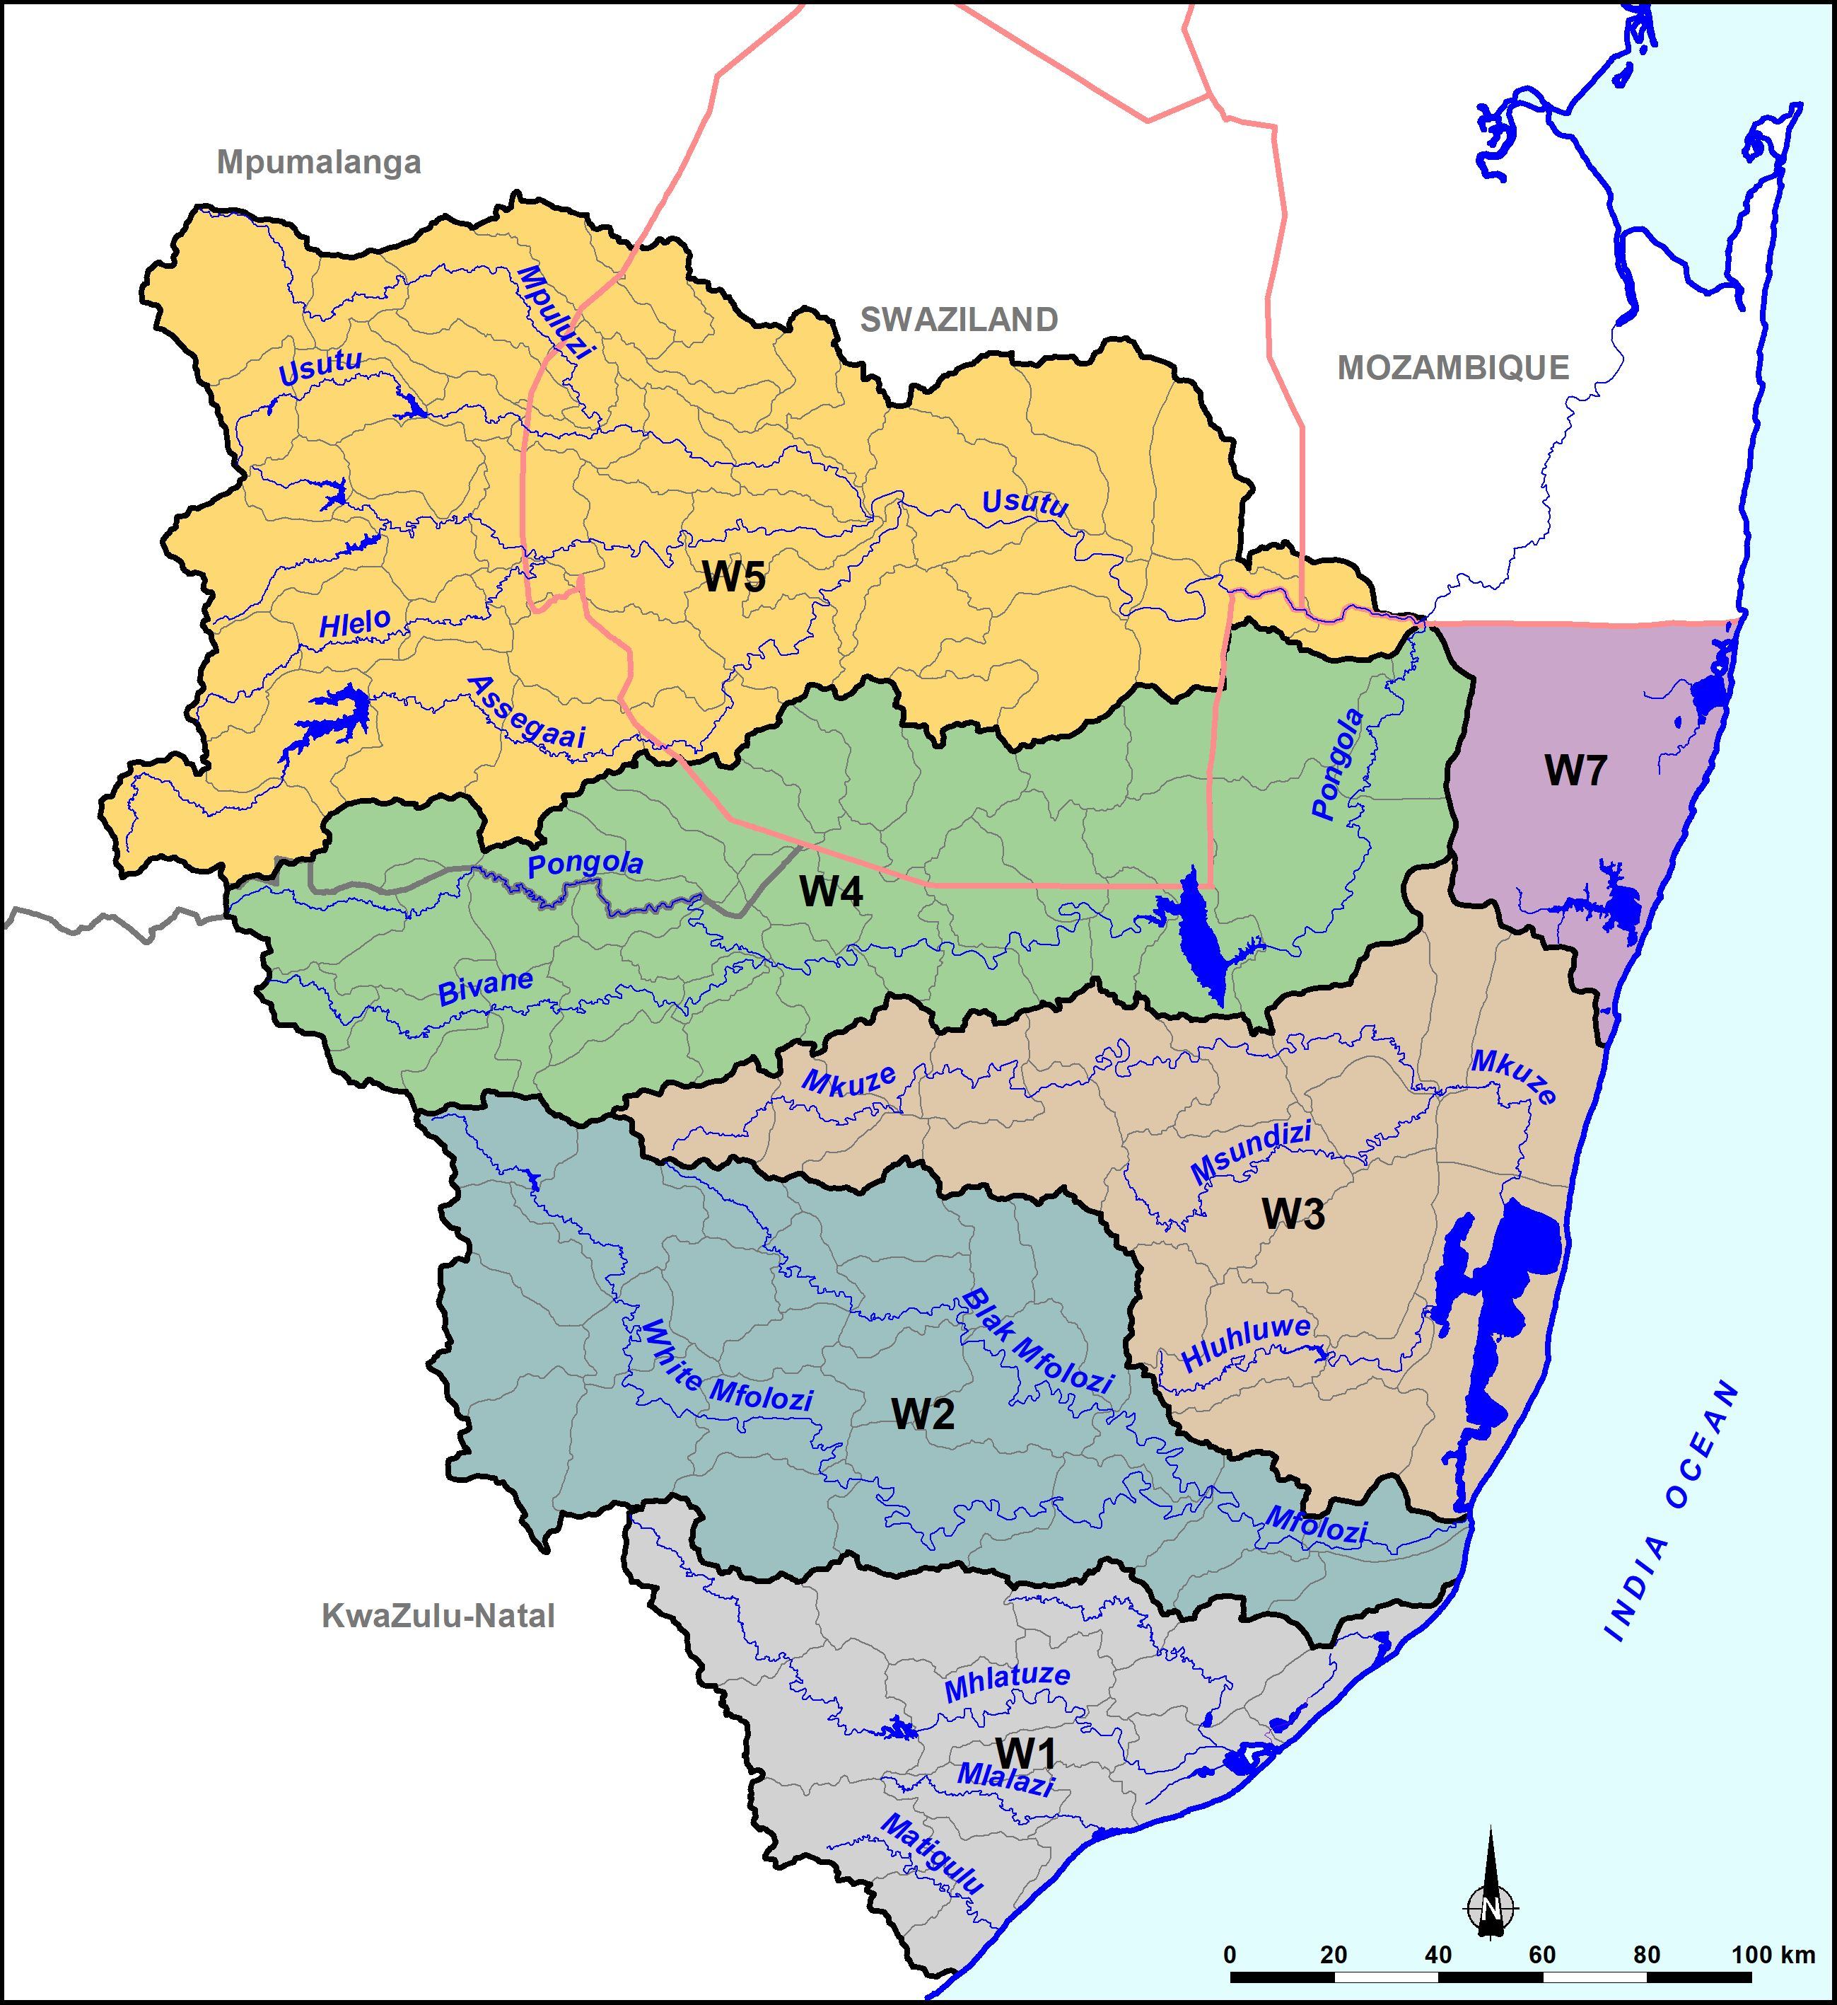
Study Area

Slide 9
WATER RESOURCE CLASSES
 | Description of use | Majority of ecological categories
Class I | Minimally used | A-B
Class II | Moderately used | C
Class III | Heavily used | D
Ecological Category (EC) - means the assigned ecological condition to a water resource . It is measured by determining how much the ecosystem has changed from natural (pre-development condition).
9

Slide 10
Process of Determining Resource Quality Objectives
RQOs 7-Step Procedure
1. Delineate the IUAs and RUs
2. Establish the vision for the catchment
3.
Prioritise & select RUs
4. Prioritise sub-components, select indicators & propose direction of change
5. Develop draft RQOs & numerical limits
6. Agree RUs, RQOs & numerical limits with stakeholders
Monitoring & Compliance
7. Finalise & Gazette

Slide 11
Stakeholder Engagement Plan
Platforms | Stakeholder groups | Purpose
Public Meetings | The broader public | To announce the project & To present the proposed classes & RQOs (1st PM held 04/05/2022)
Project Steering Committee | Representatives from various Sectors | To give strategic inputs to the project (07/06/2022, this meeting)
Technical Task team Meeting | Representatives from sectors with technical knowledge of study area and water resource management | To source comments and inputs on technical aspects of the project
Forums | Catchment management forums | Share project progress
Sectors | Different sectors e.g. Domestic, Agriculture, mining etc. ( where necessary). | Share project progress

Slide 12
Communication method
    Direct communication via meetings
    Identified Platforms: Project Management Committee (PMC), Project Steering Committee (PSC), Technical Task Group (TTG), Existing Forums, Sector, Public Meetings
    Print media
    newspaper adverts
    BIDs, newsletters
    Electronic media
    DWS internet site ( www.dws.gov.za/rdm/WRCS/default.aspx )
    Emails
  NB: Stakeholder database and Issues & Response Register to be updated regularly

Slide 13
Contact details
Mkhevu Mnisi
Tel: 012 336 6887
Email: mnisim2@dws.gov.za
Koleka Makanda
Tel: 012 336 8406
Email: makandac@dws.gov.za
Caryn Seago
012 346 3496
Email: caryns@wrp.co.za

Slide 14
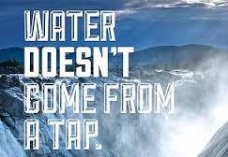

THANK YOU!

